Slide 1
As you come in today,
please complete these steps:
Open Canvas on your Chromebook.
Select the Student Advisory 12 course.
Scroll down and click on the “Senior PCCR” icon.
Click the Pre-Assessment link below.
Pre-Assessment

Slide 2
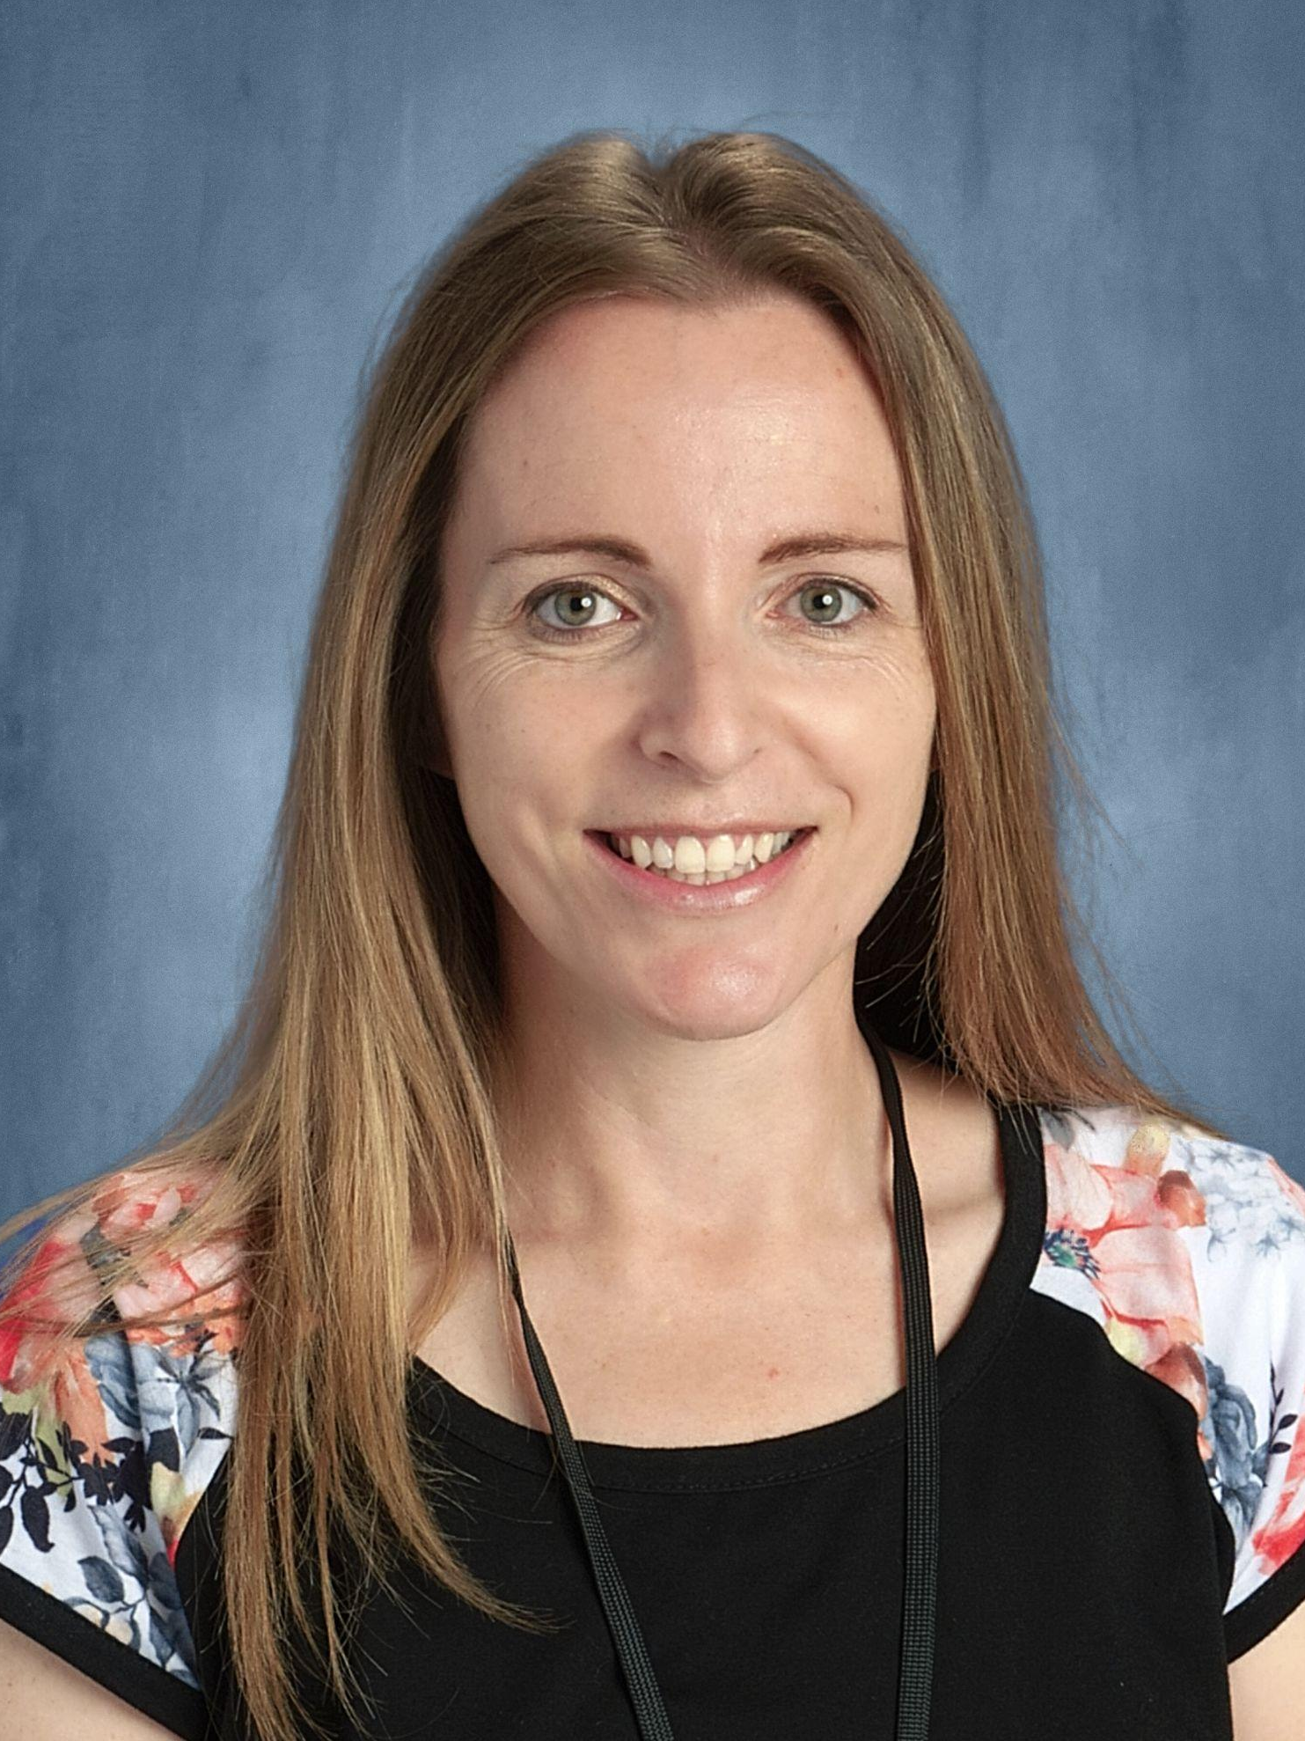
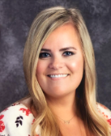
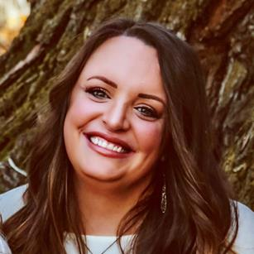
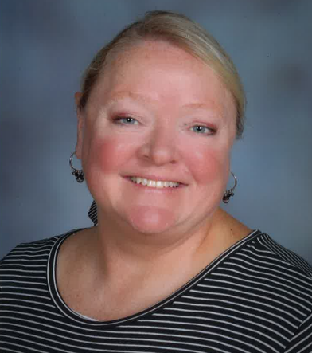
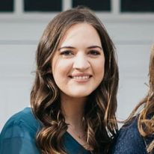
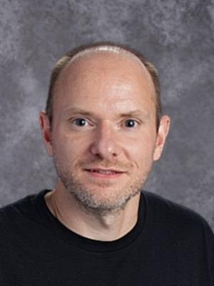
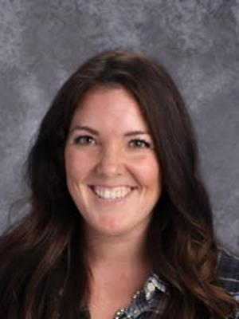
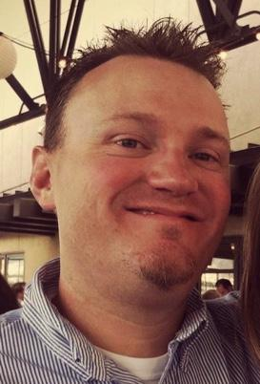
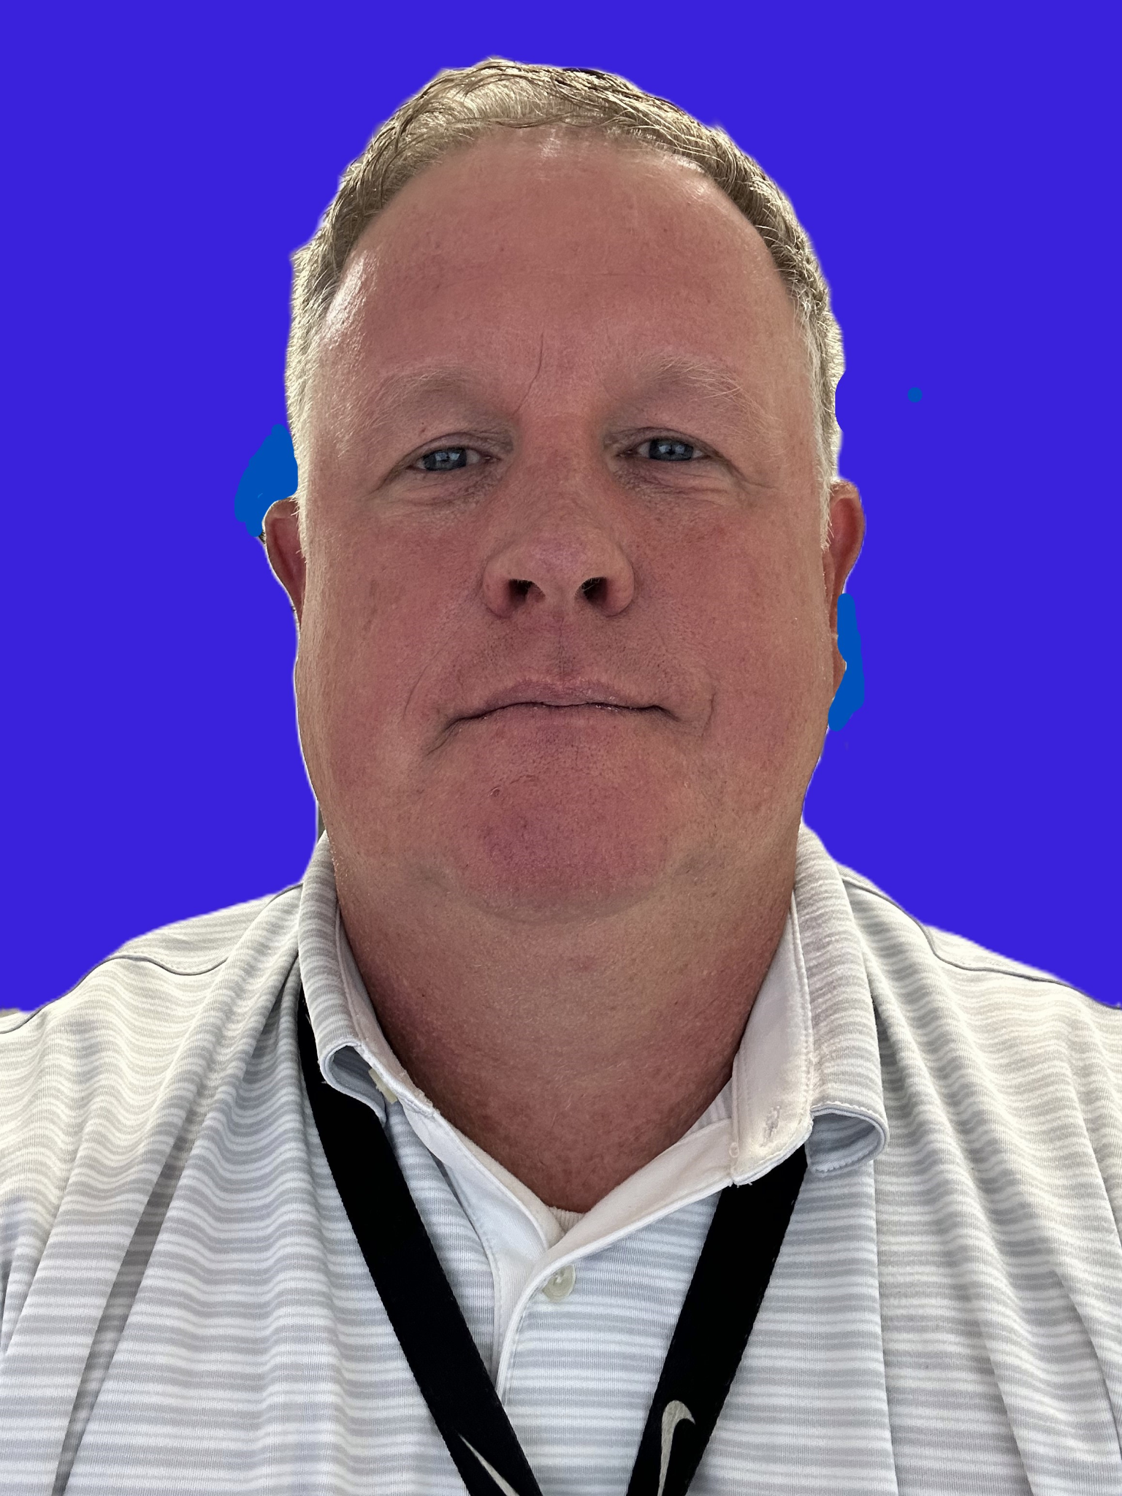
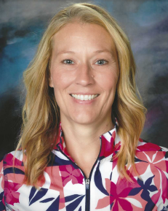
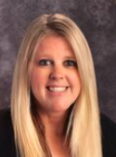
BHS COUNSELING TEAM
Mrs. Blaney
A-Can
Miss Libby
Cao-Fh
Miss Coburn
Fi-I
Ms. Mitchell
J-Mar
Mrs. Larson
Mas-Pe
Mr. Broadhead
Pf-St
Mrs. Williams
Su-Z
We are on this journey with you and happy to help!
Mr. Thurgood
Psychologist
Mr. Fait
Therapist
Mrs. Bronson
Scholarship Advisor
Mrs. Pettit
Secretary/Work Release

Slide 3
TODAY’S OBJECTIVES
Welcome to your
SENIOR
1, 2, 4 or more
Things to know for the final stretch of your journey towards HS Graduation and Post-HS Planning
PCCR
Paying for College
“Travel Budget”
4
College Applications
“Your Next Adventure”
3
Keep going!
BHS Opportunities
“Points of Interest Along the Way”
2
1
HS Graduation
“Yes, you’re almost there!”
BHS

Slide 4
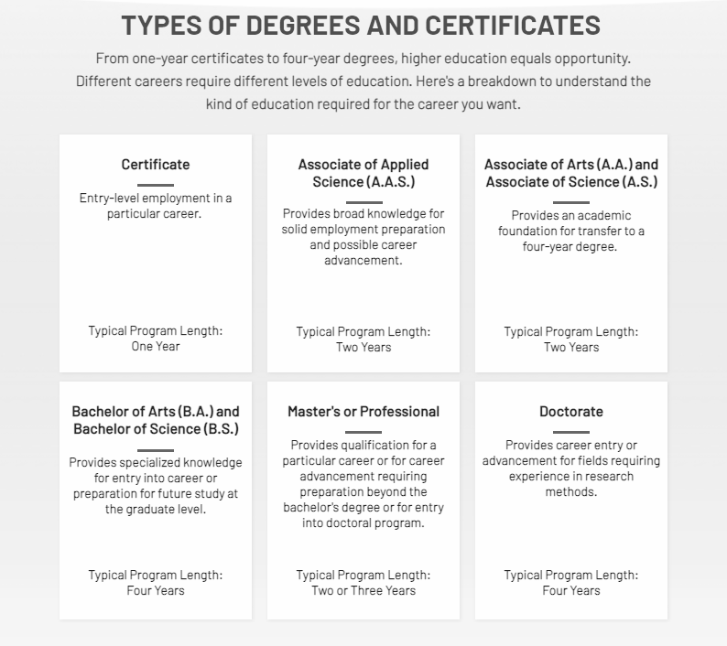
Where are you going?
1, 2, 4 or More
Higher education can be 1, 2, 4 or more years, depending on the program.
Certificates:
  Jordan Academy for Technology & Careers
  Ogden-Weber Technical College
  Mountainland Technical College
Certificate of Completion
  SLCC
  Bingham courses
Associate Degrees
Bachelor Degrees
Graduate Degrees
BHS
Keep the destination in mind.

Slide 5
NAME ON YOUR DIPLOMA
Use this spreadsheet to verify that your name is spelled and formatted correctly.
Ensure that your name appears exactly as it appears on your birth certificate.
Since your middle name is optional, you’ll have an opportunity to choose to include or exclude it from your diploma.
If your name is incorrect, or you would like to exclude your middle name, use this google form.
HS Graduation
“Yes, you’re almost there!”
1

Slide 6
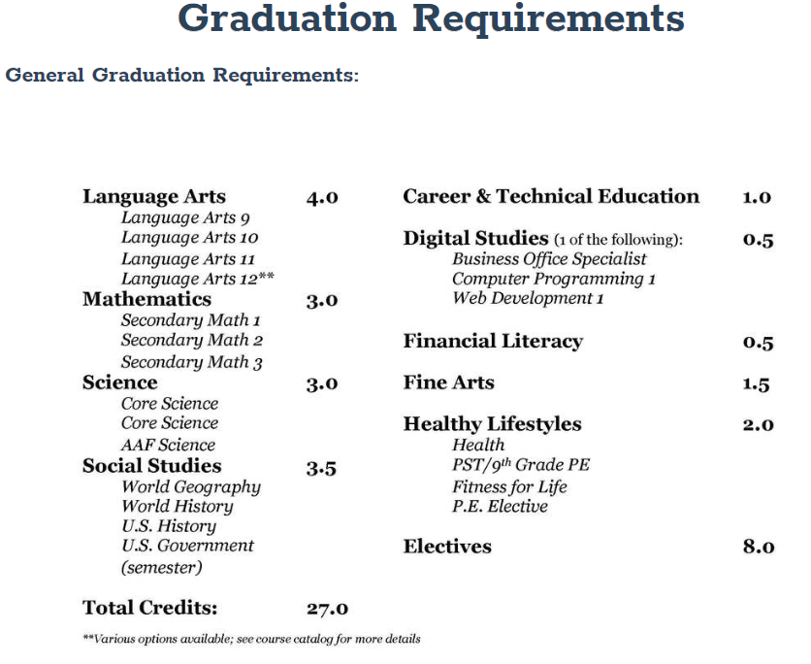
“PROCEED TO THE ROUTE”
Are you on track for graduation?
Graduation Credit Worksheet
All makeup credit must be completed before May 1.
Counselors are meeting with deficient Seniors, so you will be called down if you’re not on track.

Slide 7
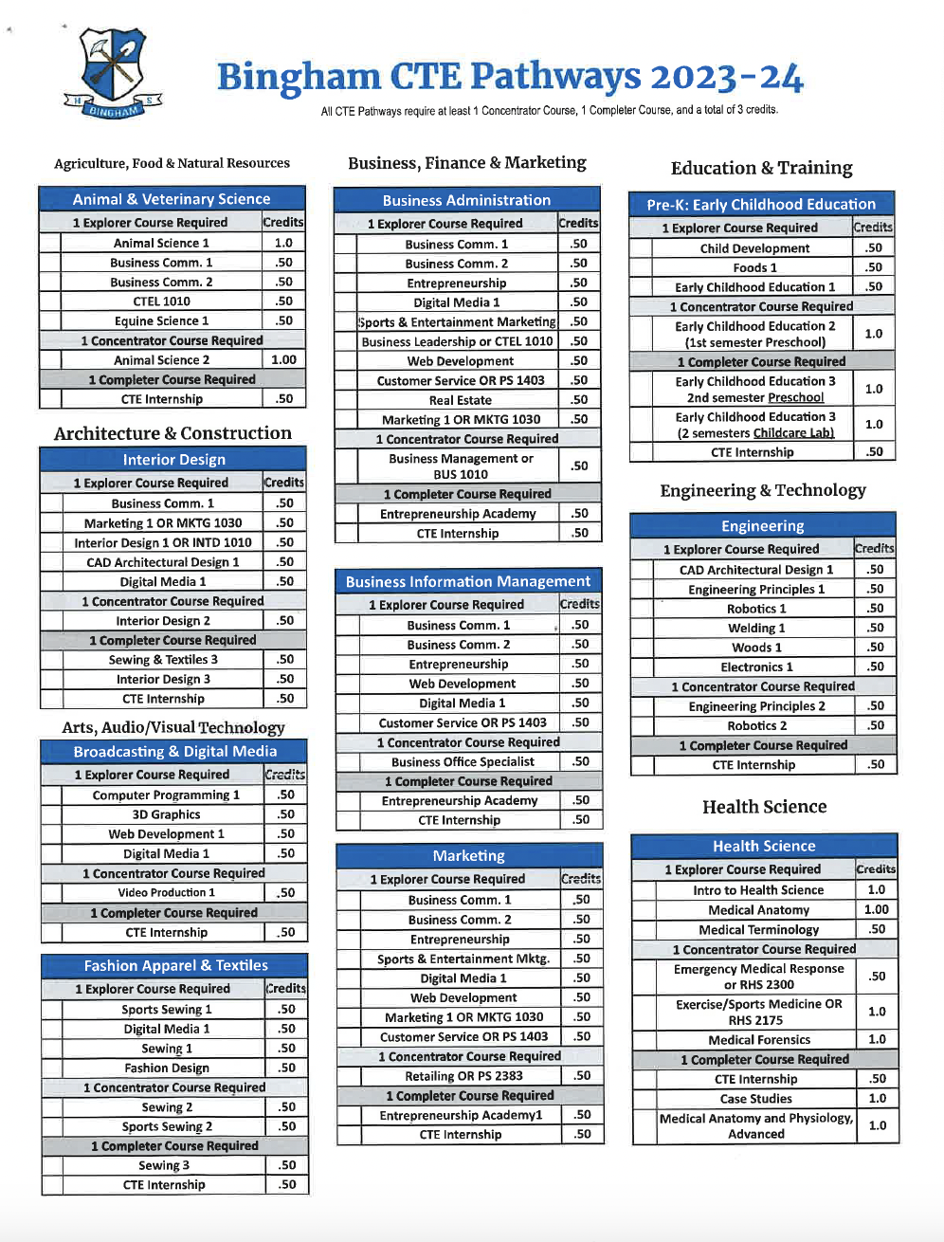
BHS CTE Pathways
Click HERE for a list of pathways and required courses
Animal and Veterinary Science
Interior Design
Broadcasting and Digital Media
Fashion Apparel and Textiles
Business Administration
Business Information Management
Marketing
Pre-K: Early Childhood Education
Engineering
Health Science
Culinary Arts
Hospitality and Tourism
Manufacturing and Production
Welding and Machining
Auto and Repair
2
BHS Opportunities
“Points of Interest Along the Way”
HOW CAN THIS BENEFIT ME?
CTE scholarships, Graduation cord,
Career exploration.

Slide 8

Miner Medallion
Majors for Miners
Graduation Cords
Bingham High School has a large and diverse student body with many talents and abilities. The purpose of the Miner Medallion is to encourage and challenge students to be involved in a wide variety of areas while attending Bingham High School. We hope to have well-rounded students who have participated in many avenues at the time of graduation.
Language Arts
Mathematics
Science
Social Studies
Health & PE
World Languages
College and Career Readiness
Performing Arts: Choral, Dance, Instrumental or Theatre
Visual Arts
CTE: Family and Consumer Science, Health Science, Business and Marketing, Skilled and Technical Science or Tech and Engineering
Click HERE for list of requirements.
Click HERE for a link to Major for Miner Applications
(Applications are due in the Spring of your Senior year)

Slide 9
























College Applications
“Your Next Adventure”
COMPARING COLLEGES
3
Public College/Universities
Technical Colleges
Private College/Universities
Compare Colleges and Universities, including degrees, costs, etc.
Be aware of application and scholarship deadlines
Virtual and on-campus tours are available
Utah Programs and Majors
Facts-at-a-Glance
NCAA Updates
Credit: Cottonwood High School

Slide 10
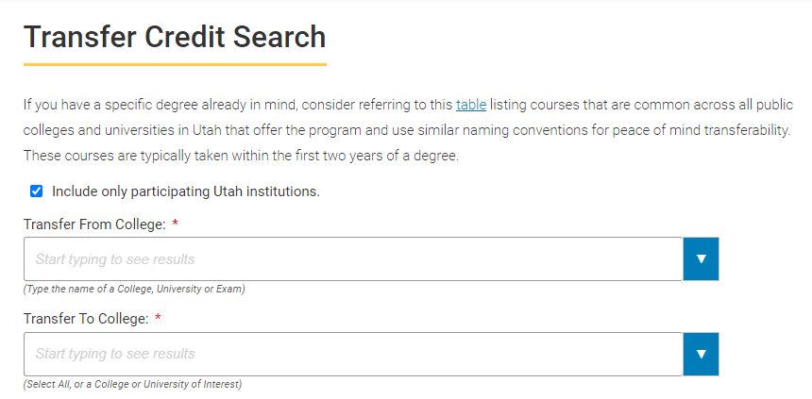
MORE COLLEGE TOOLS
Choosing a College
Keys to Success has a college search tool that allows you to filter schools by majors, location, cost, admissions, etc…
YouScience uncover student aptitudes, then connect these aptitudes to careers and educational pathways designed to help students find relevance in school and confidence beyond.
Selecting Courses
What classes should I take?
USU Degree Finder
Find degrees and required classes
Meet with College representatives during lunches
Watch for representatives by The Mine
SLCC - CE lunch & plan sessions once a month
What is an Articulation Agreement or Transfer Guide?
Guide for transfer credit between two schools.
Utah Transfer Guide
BYU Transfer Guide

Slide 11
COLLEGE TOURS
November 11 - Weber State Tour
  9:05 - 2:30
November 12 - Snow College Tour
  8:30 - 3:00
November 13 - Utah State Tour
  8:30 - 3:00
November 18 - BYU Tour
  8:50 - 1:00
November 19 - UVU
  9:05 - 2:00
November 21 - SLCC Tour
  9:00 - 1:00
Come and experience campus first hand, talk to an ambassador, get all of your questions answered about the schools.
Sign up in the counseling office and pick up your permission form at that time. It will be a first come first serve basis when you turn in your permission slip.

Slide 12
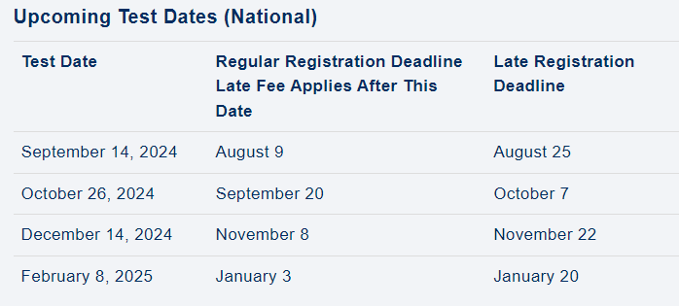
COLLEGE TESTING
Dates
ACT vs SAT
Residual ACT/On-Campus ACT
Some schools are test optional for admissions and/or scholarships (please review the individual college websites for their policies)
Click to learn more about the ACT or SAT
ACT.org

Slide 13












UCAW - UTAH COLLEGE APPLICATION WEEK
https://ushe.edu/utah-college-application-week/
Oct 1st & 2nd during your LA Class
Start and/or finish at least ONE application
Studentaid #
Scholarship Help
Letter of Recommendation Worksheet
Request your transcripts through Parchment
YouScience - Career exploration and aptitude test.
Application information worksheet

Slide 14
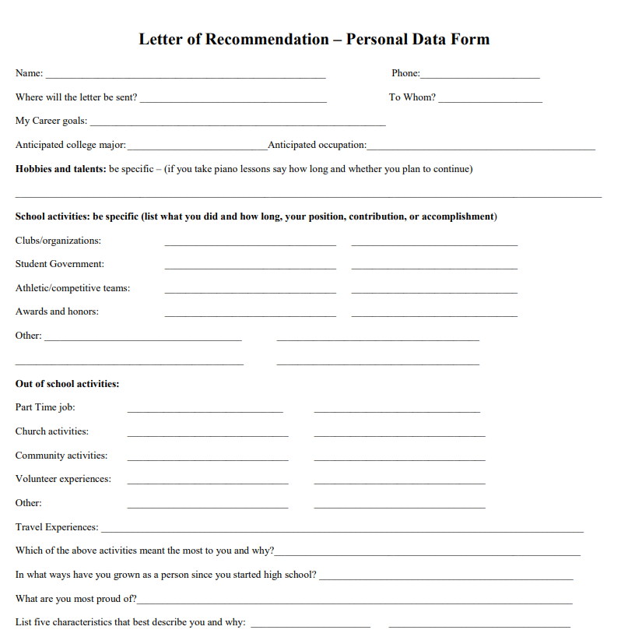
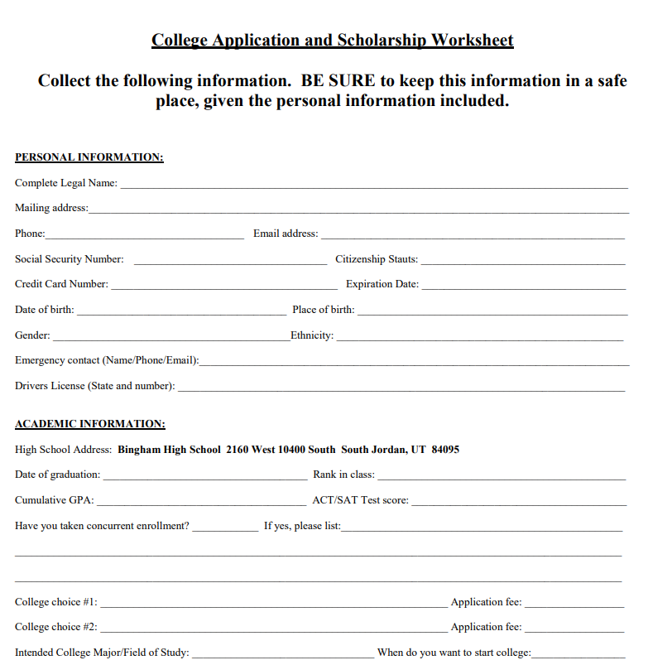
WORKSHEETS
**Electronic copy:
You can save a copy of recommendation form in canvas, edit, re-share with teacher or counselor.
Letter of Recommendation
Why should you get one?
How is the worksheet helpful for the person writing the letter?
When should you ask for letter of recommendation?
Not for University of Utah Common App!!!
College Application Worksheet
Helpful to complete college applications during UCAW
Use your personal email

Slide 15
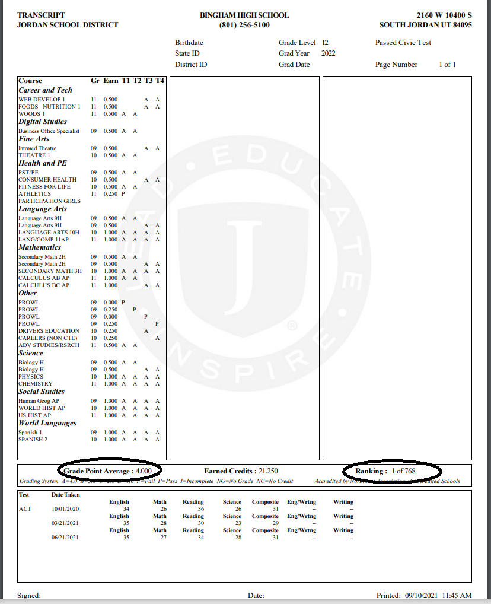
OFFICIAL TRANSCRIPT
You will get your transcript at UCAW
Class Rank and GPA appear right below your classes and grades
ACT scores are listed at the bottom
NCAA - be aware of these requirements if this is your goal. Talk to your counselor if you have any questions.

Slide 16
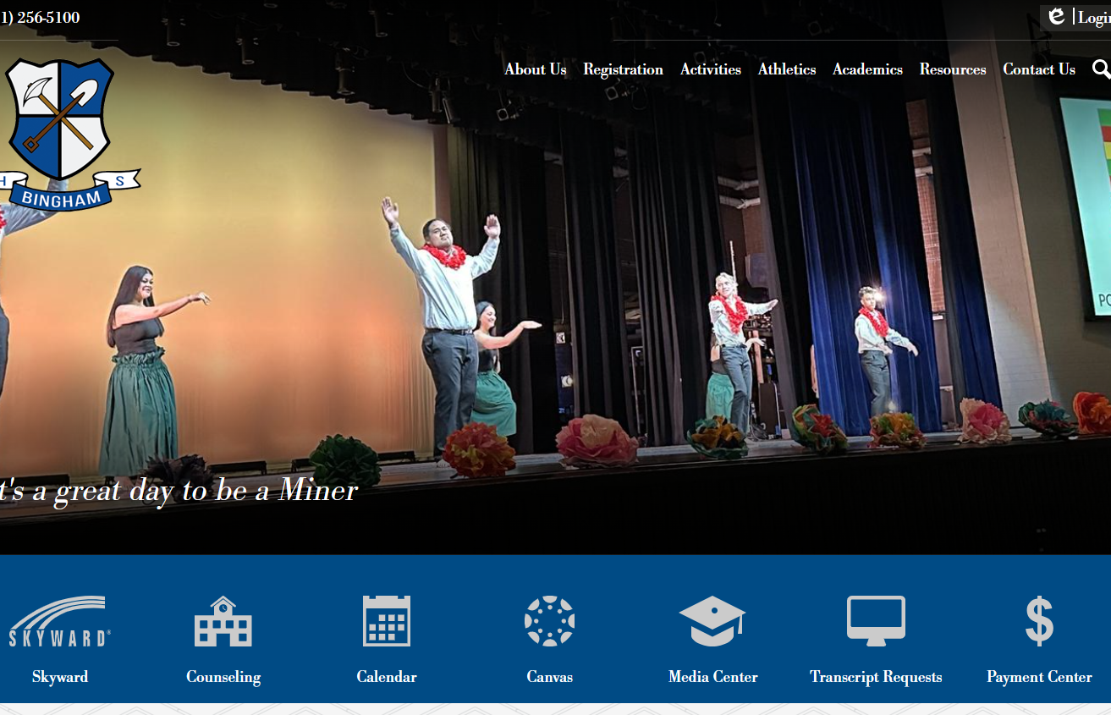
PARCHMENT FOR TRANSCRIPT REQUESTS
Parchment is used for ALL transcript requests.
Your counselor cannot send your official transcript to schools - you must use Parchment.
An individual code will be emailed to your school email before UCAW.
***(Please don’t attempt to use Parchment without your registration code or registration link. Two accounts will create a delay in any requests.)***
Binghamminers.org homepage
Access directly from the Bingham homepage

Slide 17
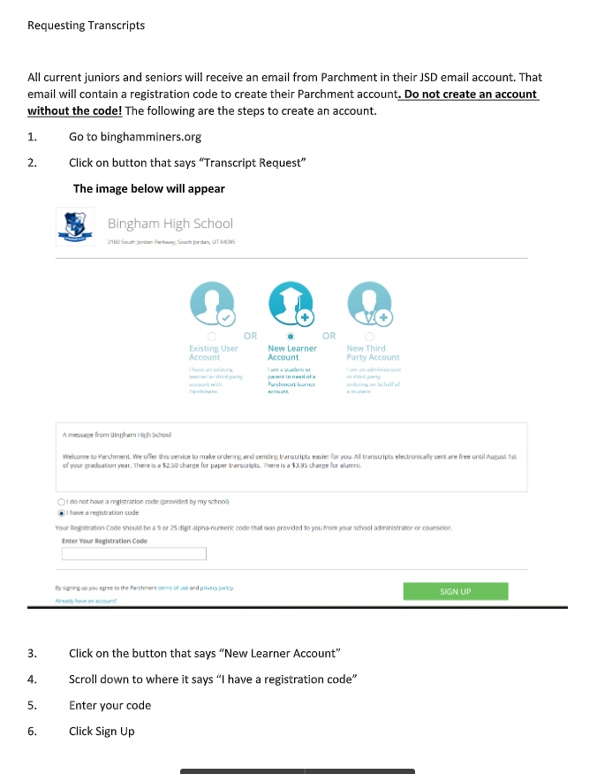
PARCHMENT ACCESS
Follow these instructions to access Parchment.
If you’ve already created an account and don’t remember your password, you can reset it. Do not create a duplicate account.
Parents should not create the account.
Use your personal email address.
Enter your individual code here (the one being emailed to you).

Slide 18
SCHOLARSHIPS
Paying for College
“Travel Budget”
4
Find scholarships on the Bingham counseling website
Upcoming Scholarships are published monthly in the counseling newsletter.
Sign up to get scholarship reminders through Remind 101 by sending a text to 81010 with the code that corresponds with your last name
B
Click HERE to sign up to see Mrs. Bronson
Seniors Remind 101(class code by last name)
A - C @2025bhsr1
D - G @2025bhsr2
H - J @2025bhsr3
K - M @2025bhsr4
N - R @ 2025bhsr5
S - Z @2025bhsr6
How much did last year's seniors earn?
Is there a limit on scholarships?
90% of scholarships come directly from the university or college

Slide 19
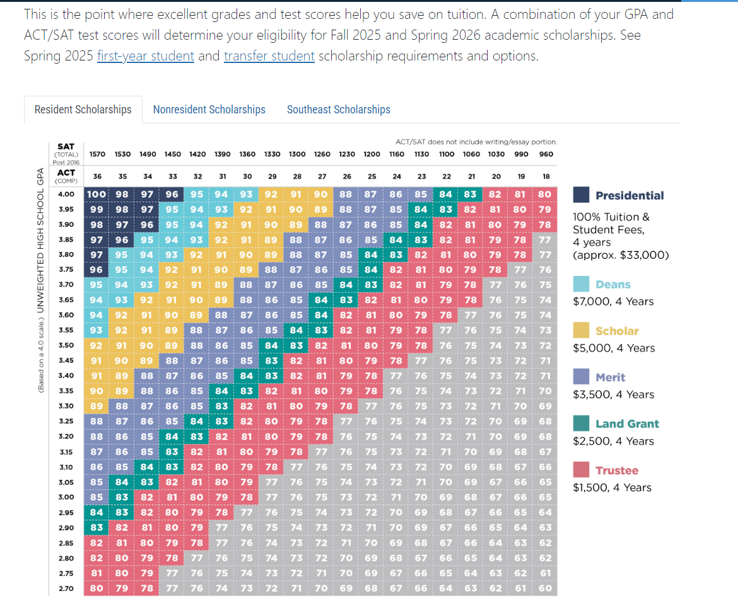
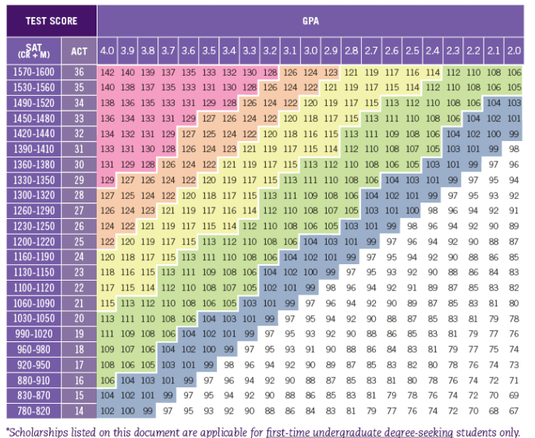
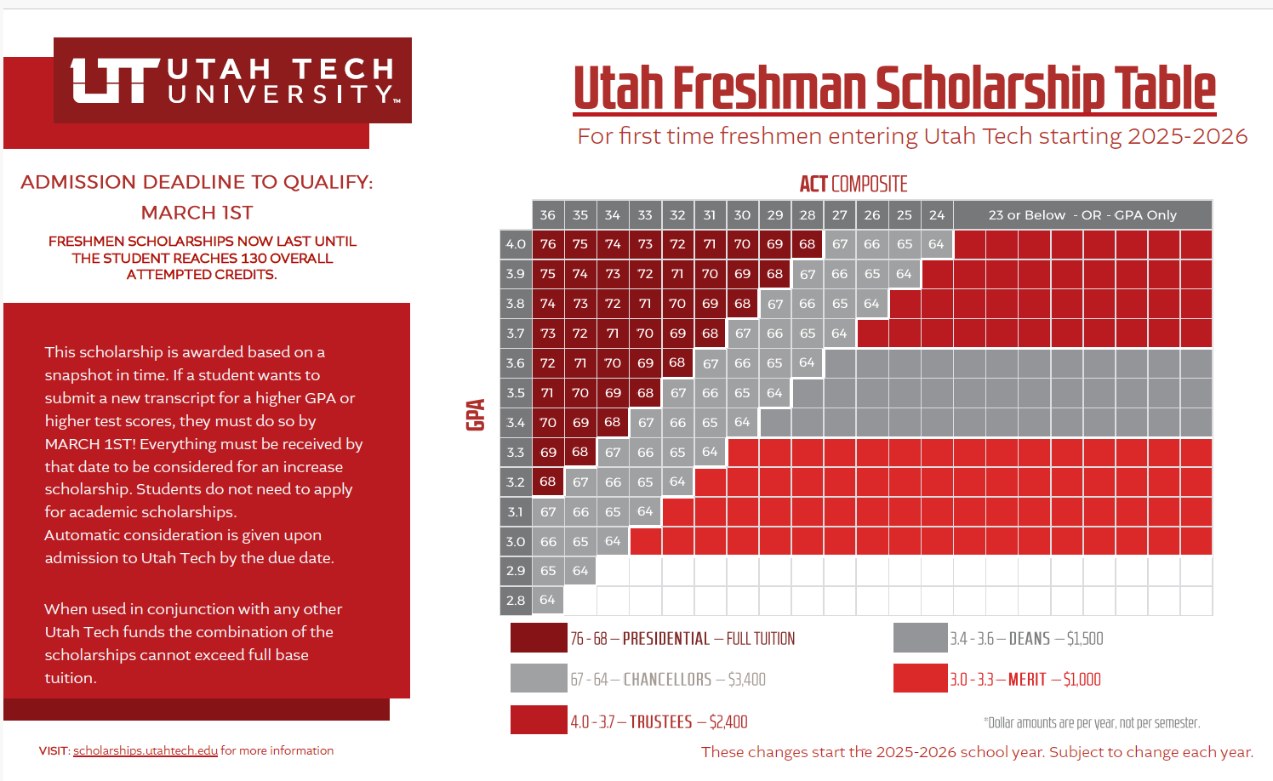
INDEX SCORES
Not all schools publish their index.
Schools that do publish:
Utah Tech, Snow College, Utah State, Southern Utah, Utah Valley and Weber
Index charts are found on the institution’s website, as well as the links above.

Slide 20
FAFSA
(Free Application for Federal Student Aid)
What is FAFSA?
  Free Application for Federal Student Aide
Why should you file the FAFSA?
  Required for many scholarships (ex. Opportunity Scholarship)
  Often incorporated as part of the admissions process
  Grants, Work Study, Loans
How long does it take to fill out the FAFSA?
  45 - 60 minutes
When does FAFSA open?
  December 1st
What if my parents “make too much money?”
  Still complete for scholarship awards
Apply now for your Studentaid number
Studentaid.gov
You will have time during UCAW to apply for this number.
Start here!

Slide 21
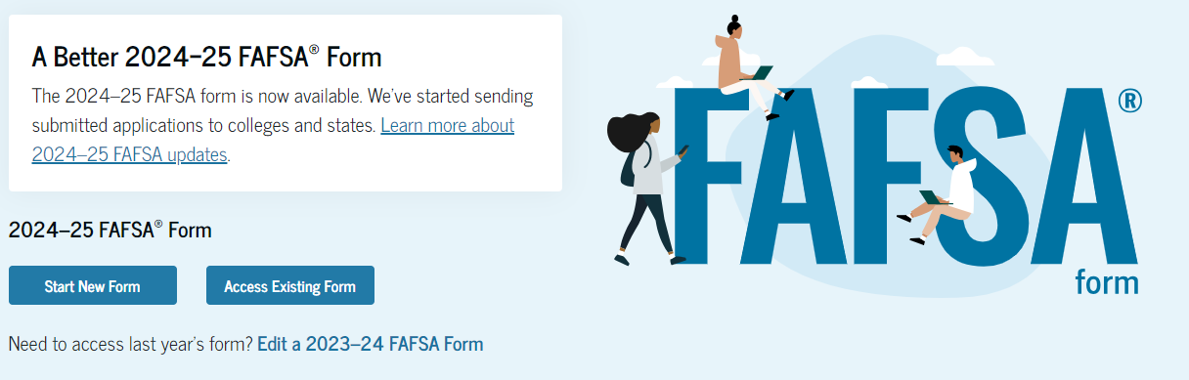
FAFSA NIGHT
What will you need?
Studentaid # for YOU and YOUR parents
Driver’s License
Social Security Number
Most Recent Tax Information
Bank Information
Date: January 14th
Time: 6pm-8pm
Location: Tech Atrium
We’ll have 2-3 college financial aid specialists to help answer questions.

Slide 22
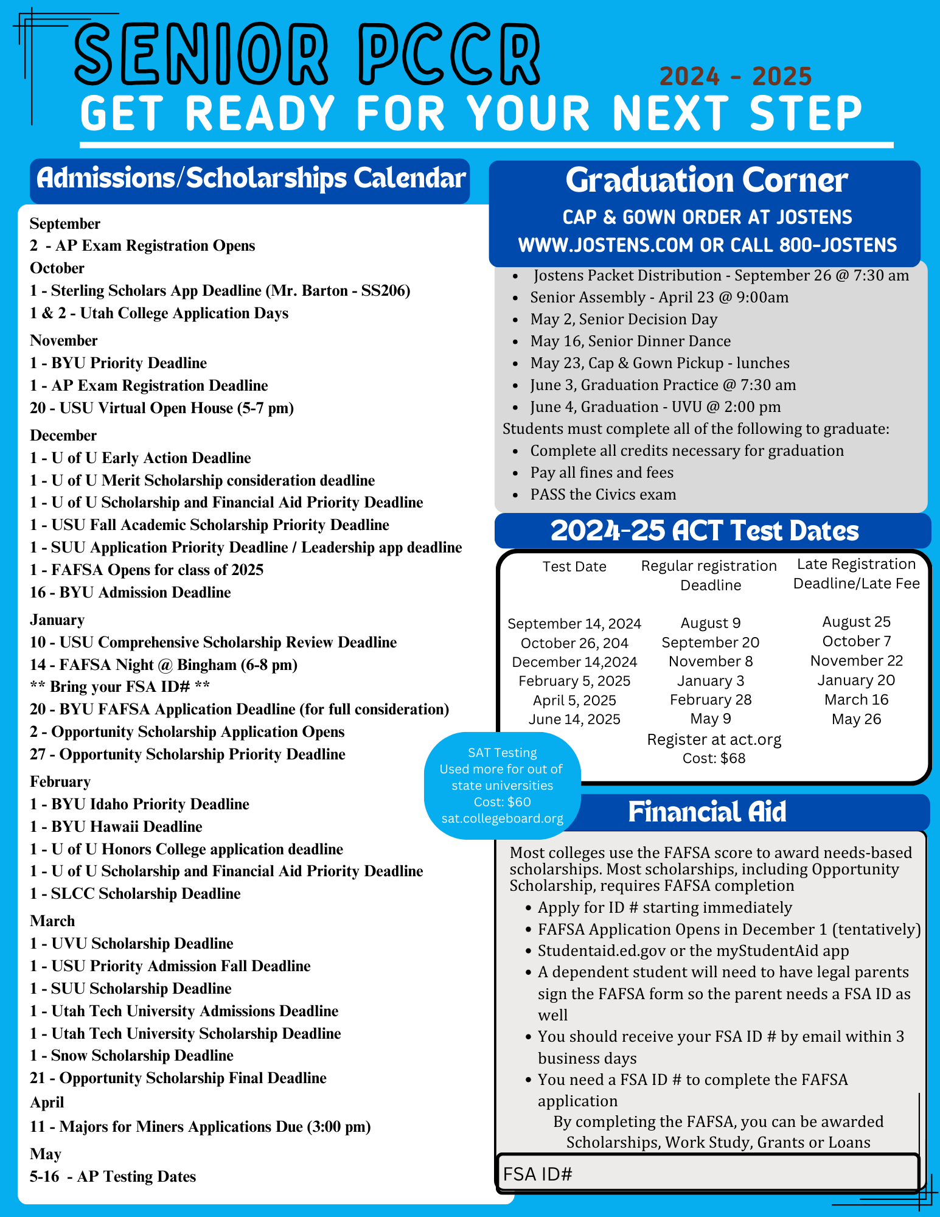
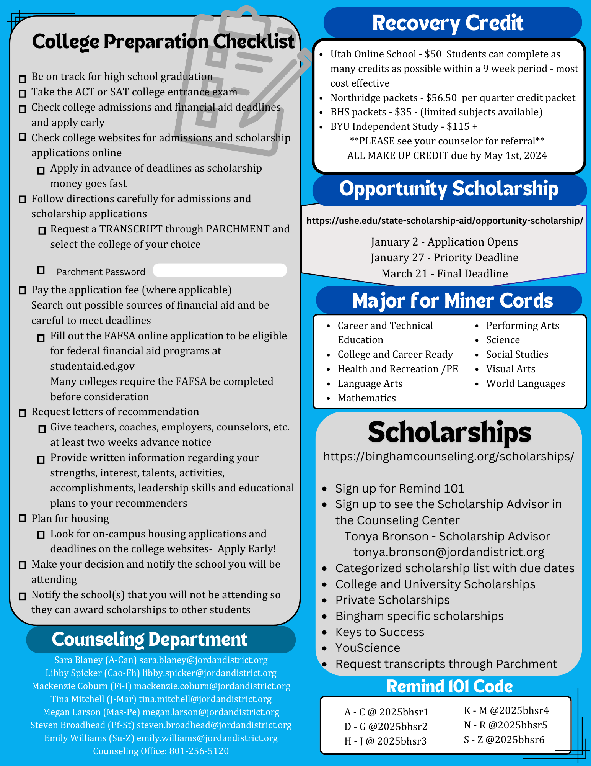
SENIOR TIMELINE
Deadlines matter!
Some ideas of how to keep track of deadlines:
Highlight the important dates for you.
Put reminders in your phone.
Refer to this sheet often.
BHS

Slide 23
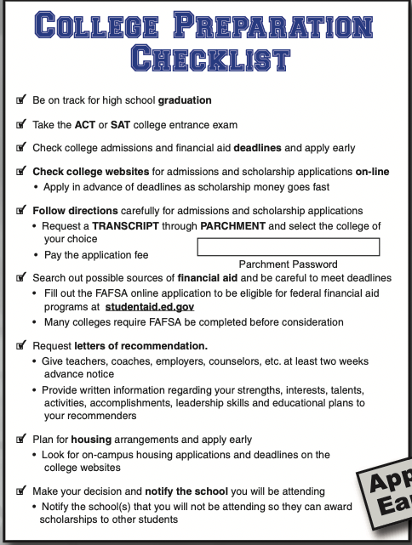

CHECKLIST and what to do after UCAW
Remember your checklist items!
Review UCAW presentation for resource links after Oct 1.

Slide 24

FINAL CHECK
Post-Assessment
Click on the link over here to see if you are ready to hit the road towards HS Graduation and Beyond!
BEEP!
BEEP!
BHS

